Slide 1

GPU Computing with opencl
FRANCISCO PAULO DE ABOIM

Slide 2

PUC-Rio
Francisco Paulo de Aboim
Graduated in Civil Engineering in 2009 with emphasis in Structures at PUC-Rio
Second year of Msc in Civil Engineering at PUC-Rio
Thesis: Finite Element Solver in OpenCL
Researcher at TecGraf in the Sigma3D modeling project
Notes:
PUC and tecgraf intro

Slide 3
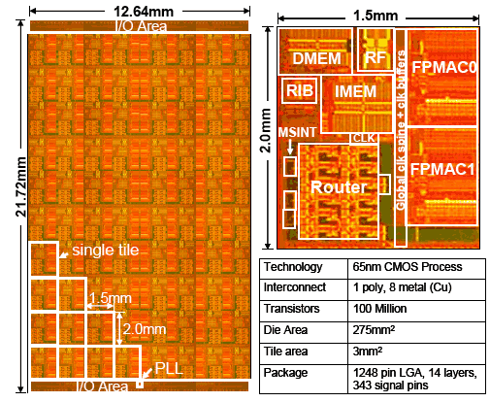
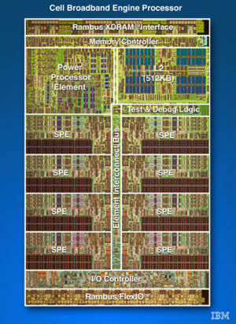
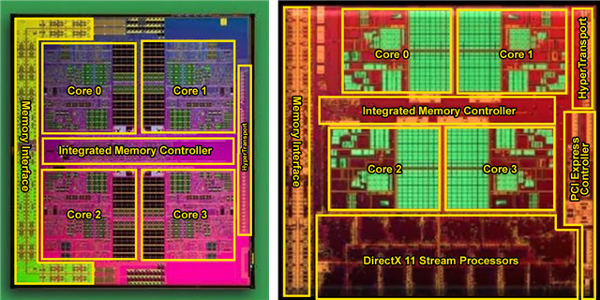
What is OpenCL?
Standard defined by a consortium of industry leaders (AMD, Intel, Apple, Nvidia, IBM…)
Heterogeneous programming platform, meaning not only GPUs but also CPUs, DSP, Accelerators (i.e. IBM CELL)
Exposes underlying memory architecture implying more control and, therefore, potential performance gains
Notes:
CELL-BE, intel 80 processor research project, llhano APU

Slide 4
Pros/Cons of Porting Code to OpenCL
Pros
Cons
Much larger potential throughput per $ spent
Better energy efficiency – Eco friendly and cheaper to run
Exposes underlying memory architecture implying more control and, therefore, potential performance gains
Code can port to different heterogeneous platforms
Easier than IL
Takes longer to program code and (much longer) to debug
Incipient technology – risk of not becoming well established
Code is harder to maintain
Because of the above development and maintenance costs are higher
Harder than most of what normal human beings use
Notes:
Cypress low-level GPU architecture

Slide 5
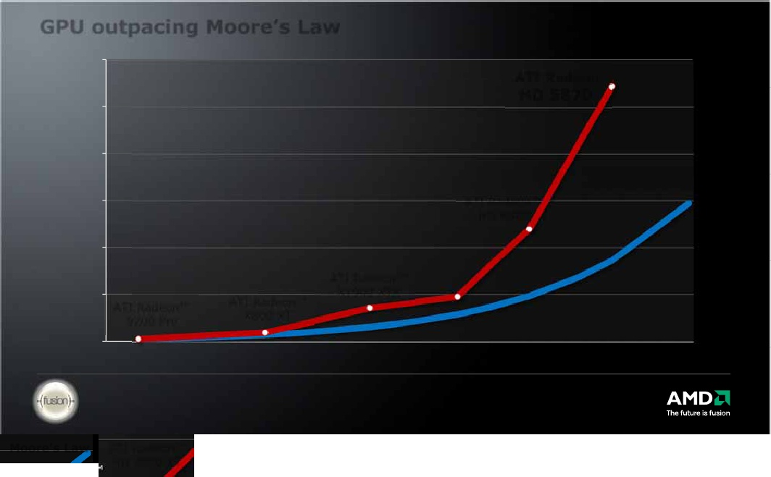
Moore’s law and GPUs
“CPU scaling predicted by Moore’s Law is now dead” – Nvidia VP
Processor transistor count doubles every two years
Clock speeds remain pretty much the same!
Instructions per clock also hit a wall (0,5 inst./clock)
Solution: more cores packed into one processor!
Because of the above development and maintenance costs are higher
AMD GPUs
Moore’s Law (CPUs)
Notes:
Moore’s Law, Memory wall, Clock wall, Instruction Wall

Slide 6
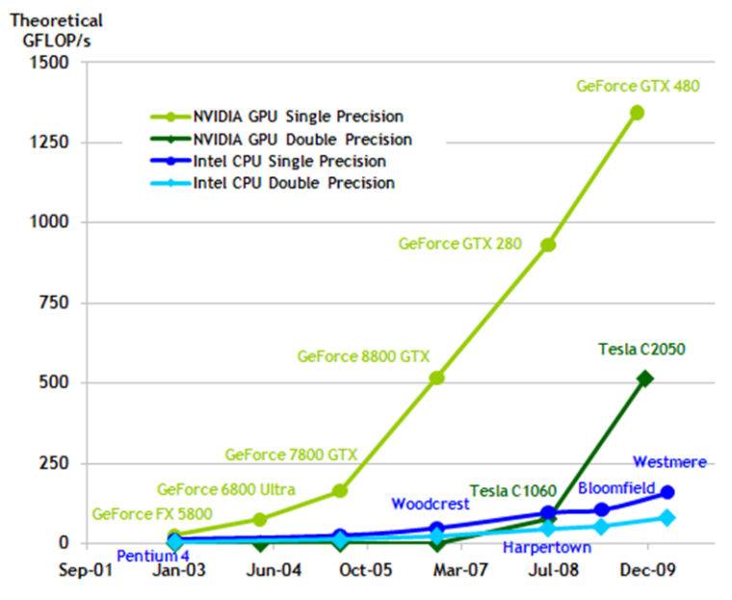
Moore’s law and GPUs
“CPU scaling predicted by Moore’s Law is now dead” – Nvidia VP
Processor transistor count doubles every two years
Clock speeds remain pretty much the same!
Instructions per clock also hit a wall (0,5 inst./clock)
Solution: more cores packed into one processor!
Because of the above development and maintenance costs are higher
AMD GPUs
Moore’s Law (CPUs)
Notes:
Cypress low-level GPU architecture

Slide 7
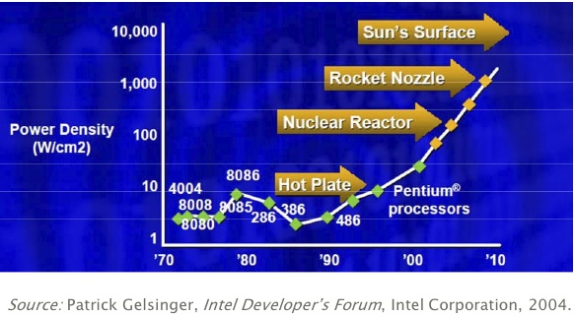
The power consumption problem
22nm gate is about 74 silicon atoms wide
Leakage is becoming an issue – quantum tunneling
Limits processor’s speeds and presents cooling problem

Slide 8
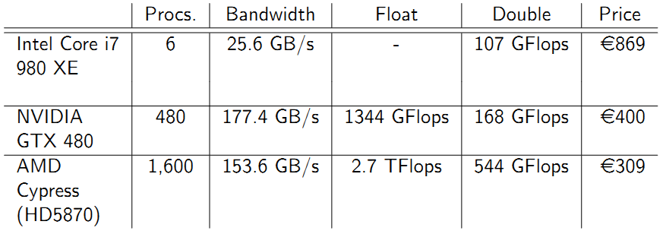
“Current” Hardware
Peak Performance

Slide 9
How did we get here?
Highly competitive gaming industry
Process more pixels and triangles - faster
Advent of (progammable) shaders
GLSL GPU computing “hack”
Recently the need for realtime video filters and image processing also fit well into the GPU model and has been adopted by the industry
Notes:
What lead to current GPU performance

Slide 10
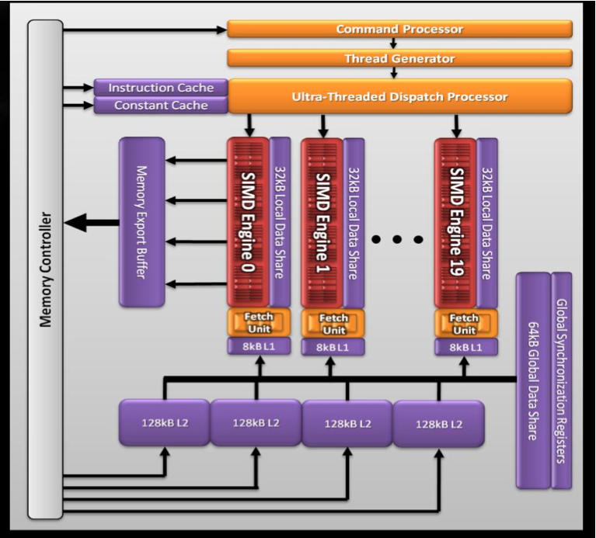
AMD GPU Hardware Architecture
AMD 5870 ( Cypress Core ):
20 SIMD engines
16 SIMD units per core
5 multiply-adds per functional unit (VLIW processing)
2.72 Teraflops Single Precision
544 Gigaflops Double Precision
Source: Introductory OpenCL SAAHPC2010, Benedict R. Gaster
Notes:
Cypress low-level GPU architecture

Slide 11

SIMD Engine
One SIMD Engine
A SIMD engine consists of a set of “Stream Cores”
Stream cores arranged as a five way Very Long Instruction Word (VLIW) processor
Up to five scalar operations can be issued in a VLIW instruction
Scalar operations executed on each processing element
Stream cores within compute unit execute same VLIW instruction
The block of work-items that are executed together is called a wavefront.
64 work items for 5870
One Stream Core
Instruction and Control Flow
T-Processing
Element
Branch
Execution Unit
Processing
Elements
General Purpose Registers
Notes:
SIMD engine discussion

Slide 12
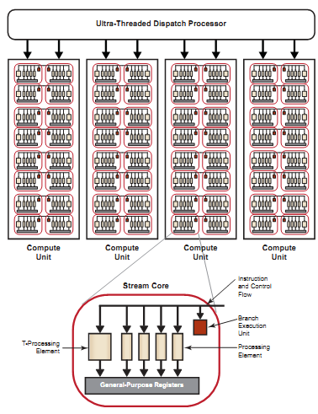
SIMD Engine
A SIMD engine consists of a set of “Stream Cores”
Stream cores arranged as a five way Very Long Instruction Word (VLIW) processor
Up to five scalar operations can be issued in a VLIW instruction
Scalar operations executed on each processing element
Stream cores within compute unit execute same VLIW instruction
The block of work-items that are executed together is called a wavefront.
64 work items for 5870
Source: AMD Accelerated Parallel Processing OpenCL Programming Guide
Notes:
SIMD engine discussion

Slide 13
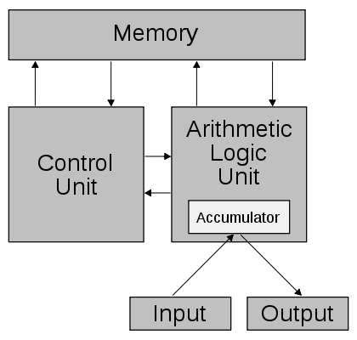
What??????
Traditional Von Neumann Architecture
Instructions are in memory
Data is also in the same memory
ALU is the “calculator”
Most basic model
Source: Wikipedia
Notes:
SIMD engine discussion

Slide 14
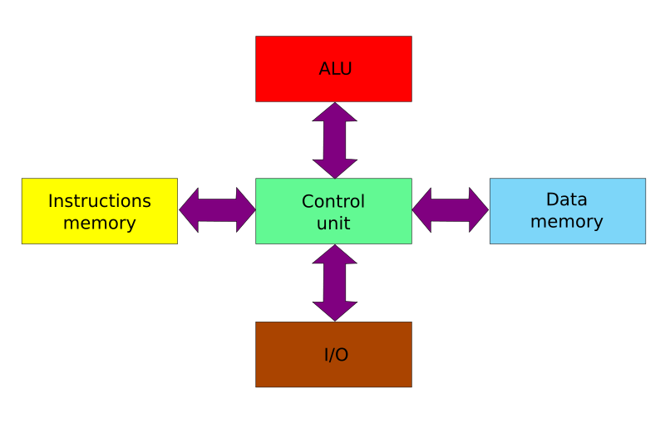
Modified Harvard Architecture
There are basically a fixed number of instructions
Separate memory for instructions – can be read only.
Data and instructions can be loaded simultaneously
Source: Wikipedia
Notes:
Von Neumann Evolution and the modified harvard architecture

Slide 15
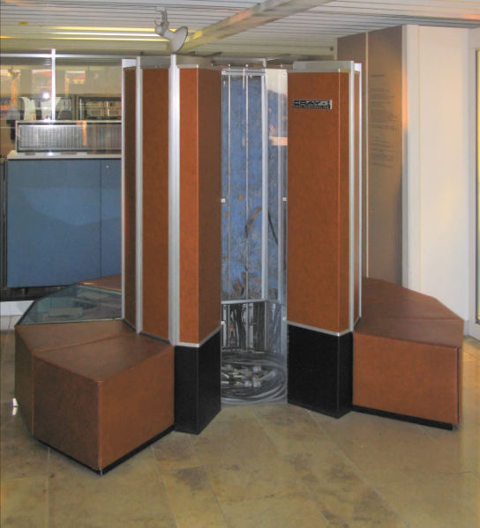
Vector Processor Architecture
SIMD – Single Instruction Multiple Data
Data parallelism(SIMD) x Task Parallelism(SPMD)
Same instruction operating on a vector of data
Program executes in lockstep
SSE and MMX for the x86 architecture
CELL BE – one scalar and eight vector processors
Source: Wikipedia
Notes:
History of vector processors

Slide 16
SIMT Execution Model
SIMD execution can be combined with pipelining.
ALUs all execute the same instruction
Pipelining is used to break instruction into phases
When first instruction completes (4 cycles here), the next instruction is ready to execute
SIMD Width
Latency
hiding
Add
Mul
Add
Mul
Add
Mul
Add
Mul
Add
Mul
Add
Mul
Add
Mul
Add
Mul
…
Add
Mul
Add
Mul
Add
Mul
Add
Mul
Add
Mul
Add
Mul
Add
Mul
Add
Mul
Add
Mul
Add
Mul
Add
Mul
Wavefront
Add
Mul
Add
Mul
Add
Mul
Add
Mul
Add
Mul
Add
Mul
Add
Mul
Add
Mul
Add
Mul
Add
Mul
Add
Mul
Add
Mul
Add
Mul
Cycle
1 | 2 | 3 | 4 | 5 | 6 | 7 | 8 | 9
…
Notes:
The SIMT Execution mode which shows how different threads execute the same instruction

Slide 17
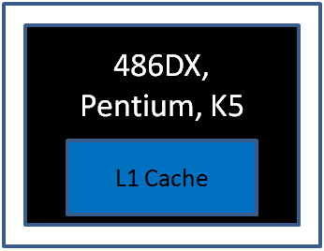
Cache Memory
While clock speeds have increased memory speeds have increased very little in the last 20 years.
Faster memory is possible but it costs much more
With the intel 386 chip, cache was introduced as an off chip add-on
Since the 486 has become standardized on chip and has included more levels as time progressed
Source: tomshardware.com
Notes:
Memory caches and the advent of hierarchical memory

Slide 18
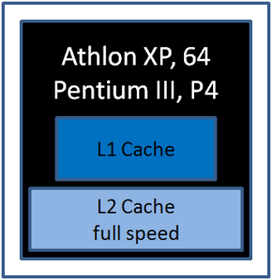
Cache Memory
While clock speeds have increased memory speeds have increased very little in the last 20 years.
Faster memory is possible but it costs much more
With the intel 386 chip, cache was introduced as an off chip add-on
Since the 486 has become standardized on chip and has included more levels as time progressed
Source: tomshardware.com
Notes:
Memory caches and the advent of hierarchical memory

Slide 19
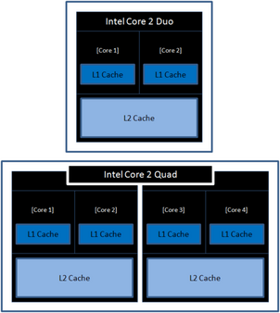
Cache Memory
While clock speeds have increased memory speeds have increased very little in the last 20 years.
Faster memory is possible but it costs much more
With the intel 386 chip, cache was introduced as an off chip add-on
Since the 486 has become standardized on chip and has included more levels as time progressed
Source: tomshardware.com
Notes:
Memory caches and the advent of hierarchical memory

Slide 20
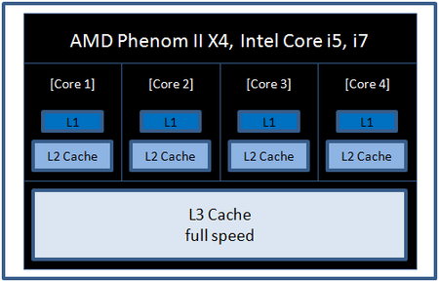
Cache Memory
While clock speeds have increased memory speeds have increased very little in the last 20 years.
Faster memory is possible but it costs much more
With the intel 386 chip, cache was introduced as an off chip add-on
Since the 486 has become standardized on chip and has included more levels as time progressed
Solution to the memory bound problem – memory hierarchies
Source: tomshardware.com
Notes:
Memory caches and the advent of hierarchical memory

Slide 21
AMD Memory Model in OpenCL
Subset of hardware memory exposed in OpenCL
Local Data Share (LDS) exposed as local memory
Share data between items of a work group designed to increase performance
High Bandwidth access per SIMD Engine
Private memory utilizes registers per work item
Constant Memory
__constant tags utilize L1 cache.
Private
Memory
Private
Memory
Private
Memory
Private
Memory
Workitem 1
Workitem 1
Workitem 1
Workitem 1
Compute Unit 1
Compute Unit N
Local Memory
Local Memory
Global / Constant Memory Data Cache
Compute Device
Global Memory
Compute Device Memory
Notes:
The mapping of the AMD GPU memory components to the OpenCL terminology.
Architecturally this is similar for AMD and Nvidia except that each ones have their own vendor specific names
Similar types of memory are mapped to local memory for both AMD and Nvidia

Slide 22
Back to the stream core..
A SIMD engine consists of a set of “Stream Cores”
Stream cores arranged as a five way Very Long Instruction Word (VLIW) processor
Up to five scalar operations can be issued in a VLIW instruction
Scalar operations executed on each processing element
One Stream Core
Instruction and Control Flow
Special
Function
Unit
Control
Flow
ALU Units
General Purpose Registers
Source: AMD Accelerated Parallel Processing OpenCL Programming Guide
Notes:
Return to discussion of the stream core

Slide 23
Back to the stream core..
A SIMD engine consists of a set of “Stream Cores”
Stream cores arranged as a five way Very Long Instruction Word (VLIW) processor
Up to five scalar operations can be issued in a VLIW instruction
Scalar operations executed on each processing element
One Double Precision Unit
One Double Precision Unit
One Stream Core
Instruction and Control Flow
Special
Function
Unit
Control
Flow
ALU Units
General Purpose Registers
Source: AMD Accelerated Parallel Processing OpenCL Programming Guide
Notes:
Return to discussion of the stream core

Slide 24
Back to the stream core..
A SIMD engine consists of a set of “Stream Cores”
Stream cores arranged as a five way Very Long Instruction Word (VLIW) processor
Up to five scalar operations can be issued in a VLIW instruction
Scalar operations executed on each processing element
All stream cores within compute unit execute same VLIW instruction
The block of work-items that are executed together is called a wavefront.
64 work items for 5870
Source: AMD Accelerated Parallel Processing OpenCL Programming Guide
Notes:
Return to discussion of the stream core

Slide 25
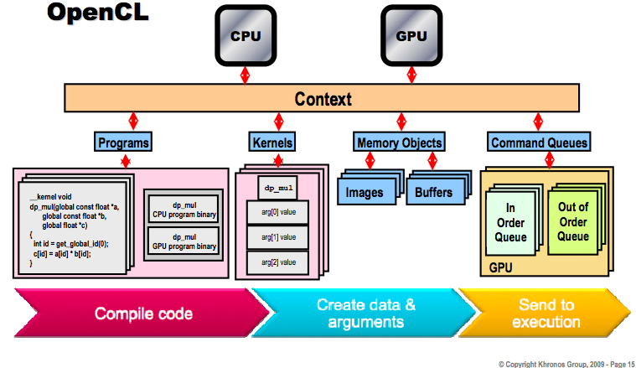
Big Picture

Slide 26
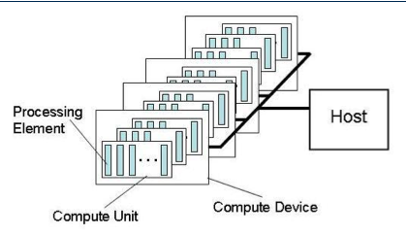
AMD Platform as seen in OpenCL
Individual work-items execute on a single processing element
Processing element refers to a single VLIW core
Multiple work-groups execute on a compute unit
A compute unit refers to a SIMD Engine
Notes:
We converge back to the OpenCL terminology to understand how the AMD GPU maps onto the OpenCL processing elements

Slide 27
An Optimal GPGPU Kernel
From the discussion on hardware we see that an ideal kernel for a GPU:
Has thousands of independent pieces of work
Uses all available compute units
Allows interleaving for latency hiding
Is amenable to instruction stream sharing
Maps to SIMD execution by preventing divergence between work items
Has high arithmetic intensity
Ratio of math operations to memory access is high
Not limited by memory bandwidth
Note that these caveats apply to all GPUs
Notes:
Discusses an optimal kernel to show how irrespective of the different underlying architecture, an optimum program for both AMD and Nvidia would have similar characteristics

Slide 28
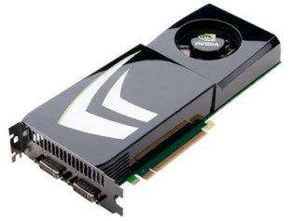
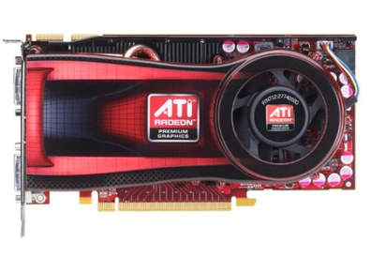
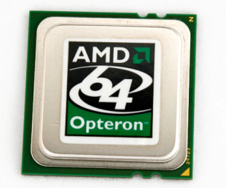
OpenCL Compilation System
LLVM - Low Level Virtual Machine
Kernels compiled to LLVM IR
Open Source Compiler
Platform, OS independent
Multiple back ends
http://llvm.org
OpenCL Compute Program
LLVM Front-end
LLVM IR
Nvidia PTX
AMD CAL IL
x86
Notes:
Explains how platform agnostic OpenCL code is mapped to a device specific Instruction Set Architecture.

Slide 29
Thread Structure
Massively parallel programs are usually written so that each thread computes one part of a problem
For vector addition, we will add corresponding elements from two arrays, so each thread will perform one addition
If we think about the thread structure visually, the threads will usually be arranged in the same shape as the data

Slide 30
Thread Structure
More work items the better for latency hiding
Threads within the OpenCL framework are called “work items”
Work items are arranged into workgroups which can share data within local memory
Barrier can be implemented for threads within a workgroup

Slide 31
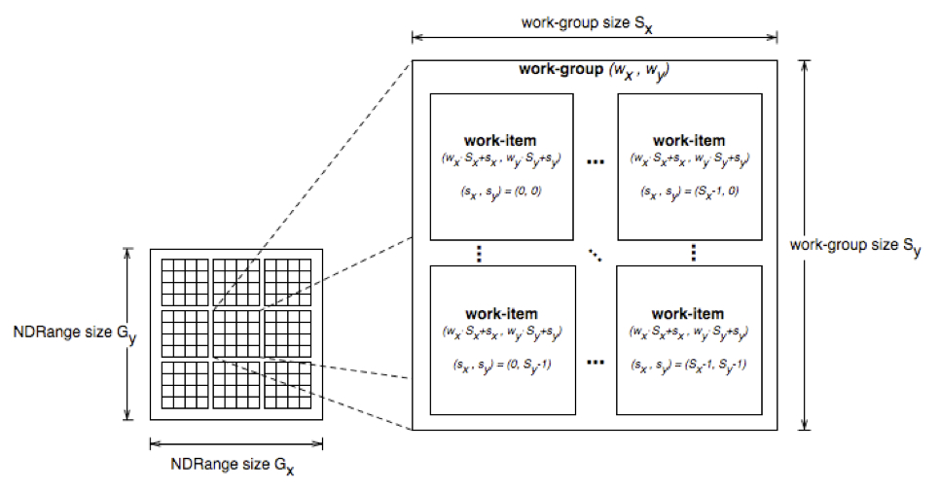
Thread Structure
Work-items can uniquely identify themselves based on:
A global id (unique within the index space)
A work-group ID and a local ID within the work-group

Slide 32
Example Kernel
Simple vector addition kernel:
__kernel
void vecadd(__global int* A,
__global int* B,
__global int* C) {
int tid = get_global_id(0);
C[tid] = A[tid] + B[tid];
}

Slide 33
Thread Structure
Consider a simple vector addition of 16 elements
2 input buffers (A, B) and 1 output buffer (C) are required
Array Indices
Vector Addition:
0 | 1 | 2 | 3 | 4 | 5 | 6 | 7 | 8 | 9 | 10 | 11 | 12 | 13 | 14 | 15
A
+
B
=
C

Slide 34
Thread Structure
Create thread structure to match the problem
1-dimensional problem in this case
Thread IDs
Thread structure:
0
1
2
3
4
5
6
7
8
9
10
11
12
13
14
15
Vector Addition:
0 | 1 | 2 | 3 | 4 | 5 | 6 | 7 | 8 | 9 | 10 | 11 | 12 | 13 | 14 | 15
A
+
B
=
C

Slide 35
Thread Structure
Each thread is responsible for adding the indices corresponding to its ID
Thread structure:
0
1
2
3
4
5
6
7
8
9
10
11
12
13
14
15
Vector Addition:
0 | 1 | 2 | 3 | 4 | 5 | 6 | 7 | 8 | 9 | 10 | 11 | 12 | 13 | 14 | 15
A
+
B
=
C

Slide 36
Take Away
Great for problems with large numbers of parallel threads and high computational intensity (e.g. Matrix Multiplication)
For full utilization of the hardware it’s necessary to find a way to fully utilize the different levels of the memory hierarchy
Branching is GPU computing’s nemesis!
Workgroup size tuning is not deterministic and takes time and lots of trial and error

Slide 37

Thanks, see you in Rio!

